Slide 1
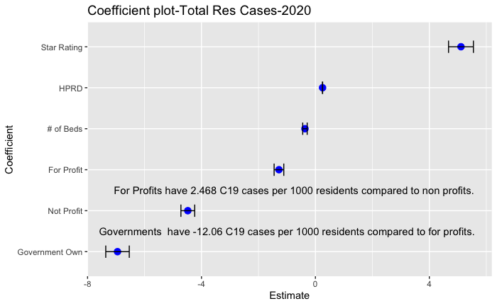
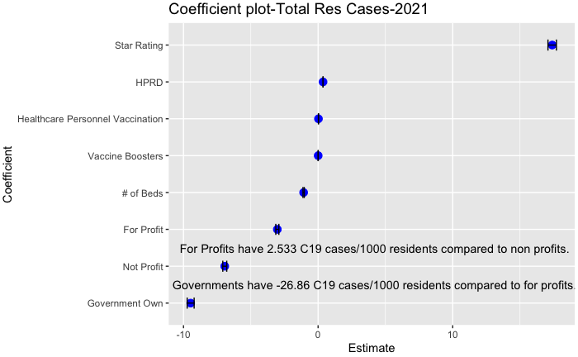
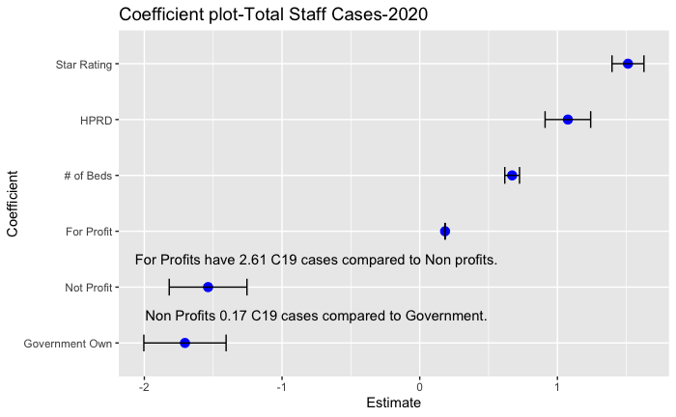
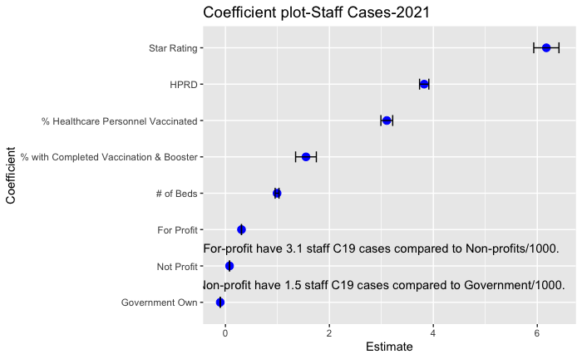

Government-Owned Nursing Homes significantly outperform both for-profit and not-for-profit nursing homes in staff and resident case transmission.
Non-Cognitive Predictors of Student Success: A Predictive Validity Comparison Between Domestic and International Students
Non-Cognitive Predictors of Student Success: A Predictive Validity Comparison Between Domestic and International Students
Government-Owned Nursing Home Outcomes in the COVID-19 Pandemic:
In 2020-Government Owned Nursing Homes had a significantly lower resident Case Fatality Rate, fewer staff and resident COVID-19 cases, than For Profit and Not-For-Profit homes, even after controlling for Quality (star) ratings and staff hours per day.
In 2021 Government-owned facilities continued to outperform not-for-profit and for-profit, even after controlling for staff COVID-19 vaccinations.
Compared to for-profit and not-for-profit nursing homes, government ownership of nursing homes is significantly associated with preferable outcomes in resident COVID-19 care. In 2020 there were significantly fewer cases of COVID-19 in government-owned nursing homes in both residents R²= .215, F(5,68721)3757 p=<.001, and staff R² =.20, F(5,68721)1.552 p=<.001 Positive outcomes in government ownership were sustained into 2021, even after controlling for staff vaccination rates. There were significantly fewer cases of resident COVID-19, R²=.36, F(7,7528)595.6, p<.001 and staff COVID-19 , R²=.32 F(7,227170)3636 , p<.001.
Conclusions: Controlling for nursing home size, staffing, quality, and vaccination of residents and staff, government ownership is associated with fewer resident and staff cases of COVID-19. This trend is observed throughout years 1 and 2 of the pandemic. The variance in outcome is explained most robustly in gross resident cases.
Highlight your name (presenter)
Annie Rhodes, Ph.D., Anna C. Novak, MS., Thomas V. Caprio, MD., Sarah Marrs, Ph.D., Tracey Gendron, PhD., Leland H. Waters, Ph.D.
INTRODUCTION
Government-owned nursing homes constitute about 6% of all US nursing homes, This is a small proportion, 70% of nursing homes are for-profit, and 24% are not-for-profit. Because there are so few Government nursing homes, they are understudied, and little is known about how Government nursing homes differ from not-for-profits and for-profits in COVID-19 outcomes.
METHODS
Government Owned Nursing Homes were compared to not-for-profits and for-profits on various COVID-19 outcomes.
N = 15338 (n=10776 for-profit, n=3599 not-for-profit, and 973 government-owned) were compared across 2020 and 2021 on staff and resident COVID cases. Facility size, quality, staffing ratios, and 2021 vaccination rates were controlled for. Data was collected from the NHSN Long Term Care COVID Module and the Medicare Provider Archives.
A series of linear regressions compared COVID-19 outcomes across years 2020 and 2021
FINANCIAL DISCLOSURES
None
Across 2020 and 2021, After controlling for staffing, facility quality, size and staff vaccination p<.001
Notes:
Notes:
In Powerpoint, click View > Guides
Keep text within gutter guides.
Author list: Don’t split names onto two lines (e.g., “Jimmy [break] Smith”). If that happens, use a new line, unless you need the space. Bold the first names of anybody who’s presenting in person.
Intro/methods/result: Do not drop below font size 28, but if you have extra space, jack up the font size until the space is full.
Do not use color in the sidebars except in graphs/figures. It’ll pull attention from the center and slow interpretation for passersby.

